Slide 1

UR QnA
A convenient, fast, and efficient way to answer questions about the University of Regina
Submitted to Sirvan Parasteh as part of the Project Requirements of CS 476
(Software Development Methodology)
By Bernadette Veninata & Zakiyyah Noorally
December 2nd 2021

Slide 2
Problem & Motivation
During the COVID-19 pandemic, the University of Regina transitioned to online learning for most students which resulted in communication bottlenecks.
Students were unable to meet employees in person during the work-from-home phase.
Voicemail was often full and unable to accept new messages.
Consequently, emails were used even though they were not the most efficient and effective means of communication.
To address the communication problems, and reduce frustration experienced by both employees and students, we designed UR QnA as a potential solution.
COVID-19 pandemic took the University of Regina by surprise. UR QnA has been designed to improve communication procedures in an online learning or a hybrid environment.
It has been developed to be a long-term solution which can be used even when the University operates in-person at pre-pandemic level.

Slide 3



Project Description
UR QnA is a web-based chat system that will provide a convenient and efficient platform for University of Regina students to ask questions they have about the University.
Students can obtain immediate answers to questions relating to the University using an online chatbot.
If the chatbot is unable to assist them, users will have the ability to schedule an appointment with a front-desk staff member to chat on a one-on-one basis.

Slide 4




Functional Requirements
User Groups
Front Desk Employees
Current Students

Slide 5
Functional Requirements
As a current University of Regina student, I want:
To register for the chat system (sign-up functionality).
To login to my account (login functionality).
To use the live chat system to ask questions about the University of Regina.
To have my questions answered in a timely manner (via chatbot or by talking to an employee).
To see a list of University of Regina employees and their status (“Available” or “Not available”).
To chat with an actual person (employee) for complicated questions I may have by
booking an appointment with them
or chatting directly with them if their status is “available” (send a chat request).
To see upcoming appointments with University of Regina employees.
To cancel an appointment with an employee should the need arise.
To be able to send a picture/file through the chat system to better explain my questions.

Slide 6
Functional Requirements
As a front-desk staff member, I want:
To register for the chat system (sign-up functionality).
To login to my account (login functionality).
To answer student’s questions through the chat system on a one-to-one basis during the regular working hours (9.00 AM to 5.00 PM).
To have my status appear as:
“Available” so that students know I am available for a live chat.
“Not available” so that students know I am currently offline or busy with another student.
To accept/reject any appointment made by a student.
To see upcoming appointments with students.
To view live chat requests of users who have not made an appointment.
To be able to accept or reject live chat requests made by students.
To be able to send a picture/file through the chat system if the need arises in order to better assist students.

Slide 7
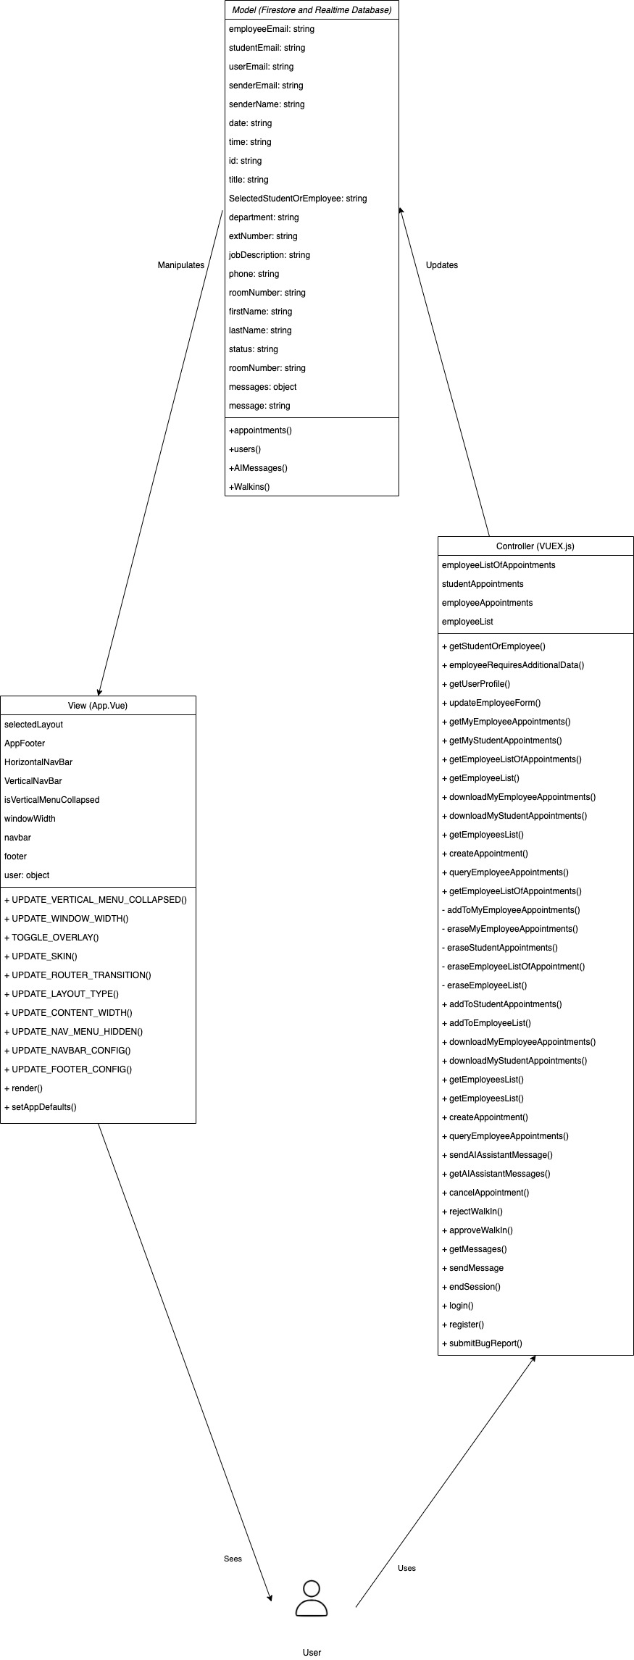
Software Architecture (MVC)

Slide 8
Software Architecture (MVC)
The corresponding code related to our MVC can be seen through the following:
App.Vue (View)
VUEX.js (Controller)
Firestore and Realtime database (Model)

Slide 9
Design Patterns
The UR QnA application adheres to the following design patterns:
The Bridge Pattern
The Abstract Factory Pattern
The Builder Pattern

Slide 10
The Bridge Pattern
The Bridge pattern decouples an abstraction from its implementation so that the two can vary independently.
The pattern will be used in our application in the case where the backend database needs to be replaced, and the front-end code should not change ‐ only the VUEX store which accesses the backend database API.
A VUEX module called database (abstraction) and a sub module called firestore (implementation) have been created. When interacting with the database at any point in the application, only the VUEX module is allowed to make calls to the API. Therefore, front end code calls the database VUEX module which will, in turn, decide which firestore submodule to use for the database.
This allows for easier code maintenance, easier upgrades to the new versions of the database or API, and easier migration from one API library to another.

Slide 11
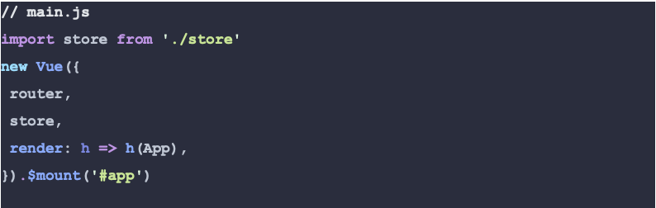
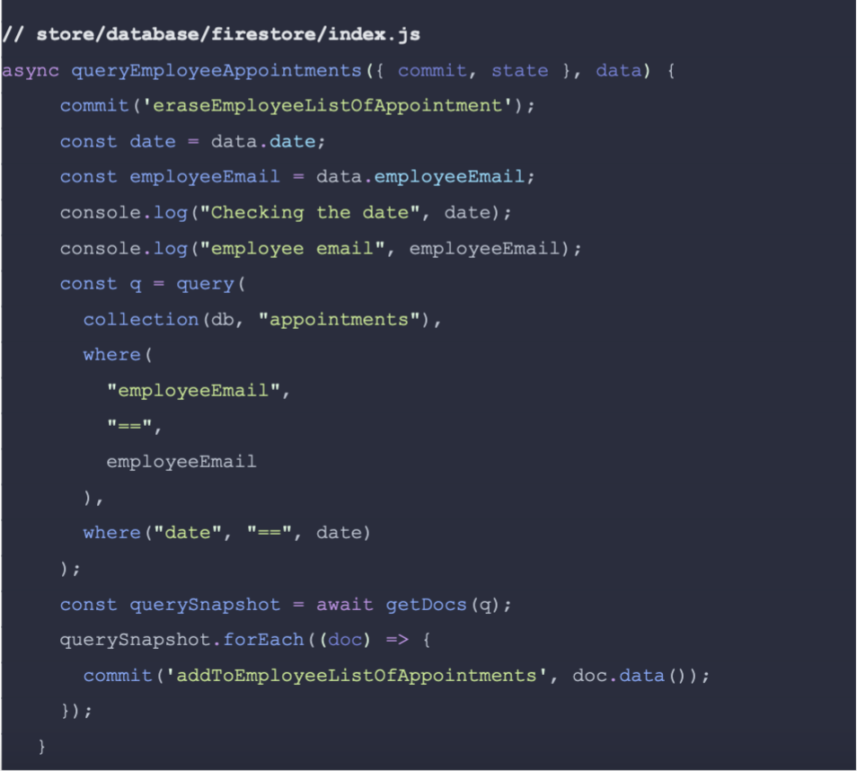
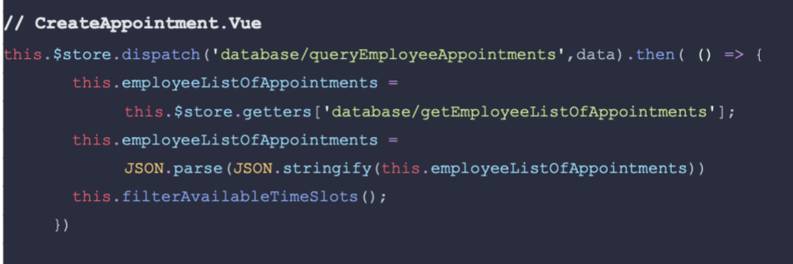
The Bridge Pattern

Slide 12
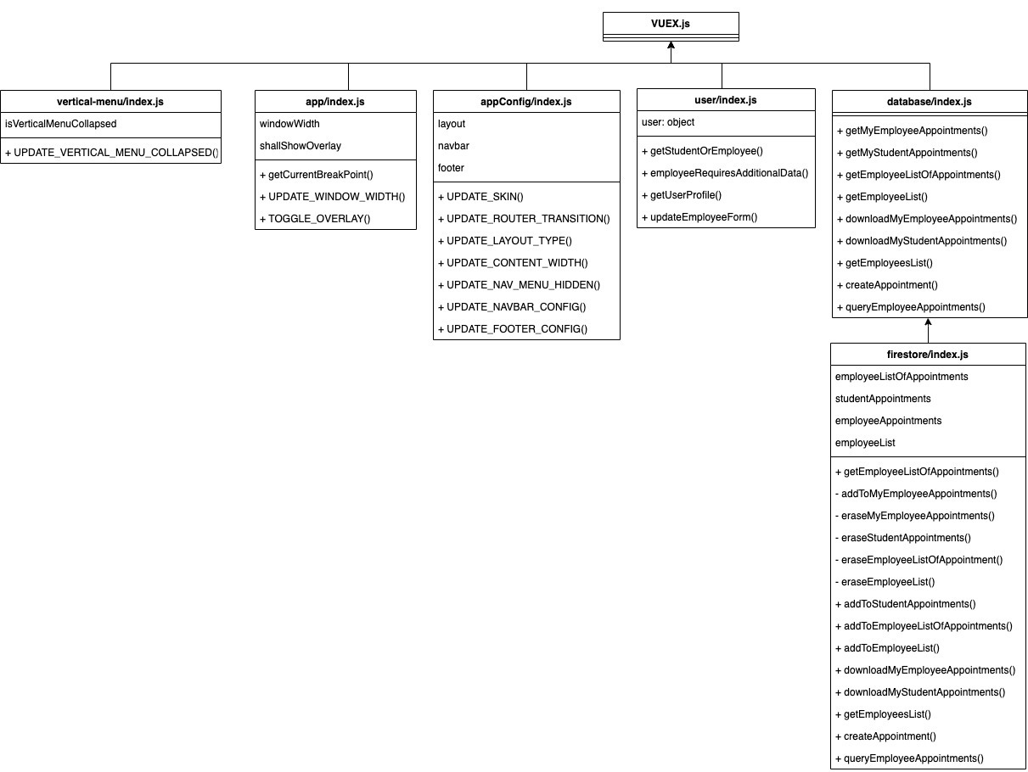
The Bridge Pattern

Slide 13
The Abstract Factory Pattern
The Abstract Factory Pattern is used in our application to create abstract factory components that are able to create and render one of several families of related components required based on client component input.
B-alert is an abstract family of alert components imported from Bootstrap that renders an alert box with custom options that we are able to define at runtime. Components such as b-button, b-avatar etc. are all being imported as abstract families from Bootstrap (factory of factories).
A separate component for every possible variation of an object would be time consuming, error prone and bad maintenance, therefore this adds greater dynamic flexibility at render time for a specific abstract component.

Slide 14
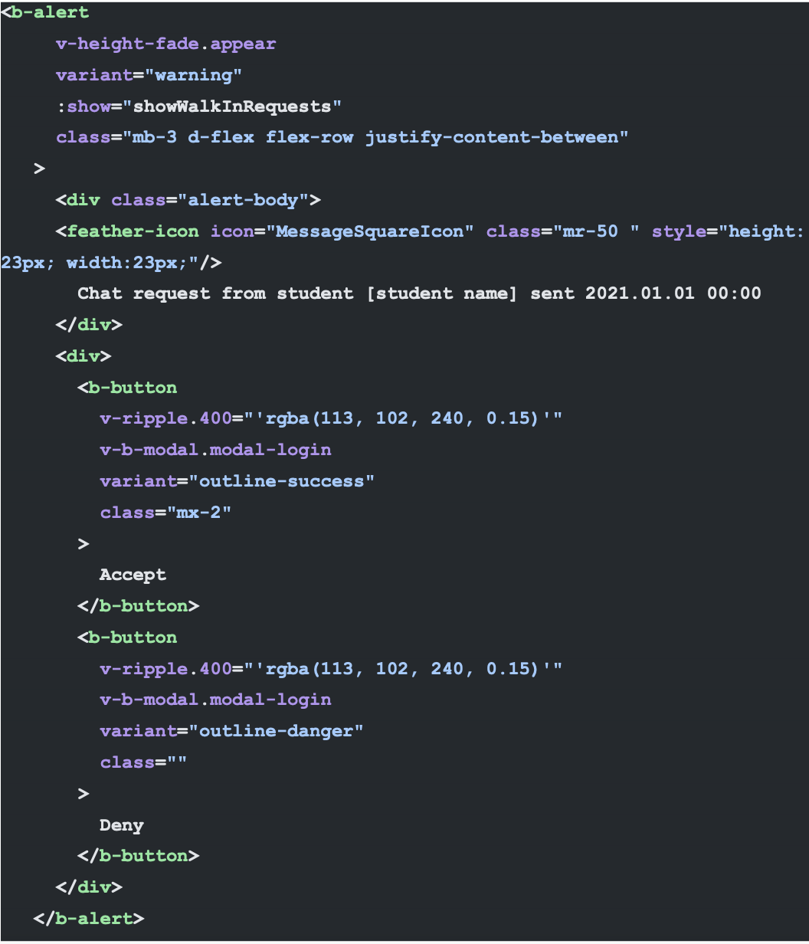
The Abstract Factory Pattern

Slide 15
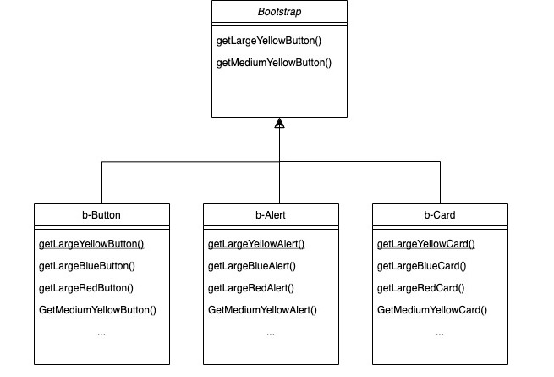
The Abstract Factory Pattern

Slide 16
The Builder Pattern
The Builder Pattern abstracts the implementation details from the main view.
This is used in our application by replacing the router view component based on the router path and its attributes, in this way the implementation (construction) details are separate from its representation.
This allows the App.vue to be simple/maintainable and only handle global events and interactions. All further details about the page and its components will be handled by the dynamically loaded component via router-view component replacement.

Slide 17
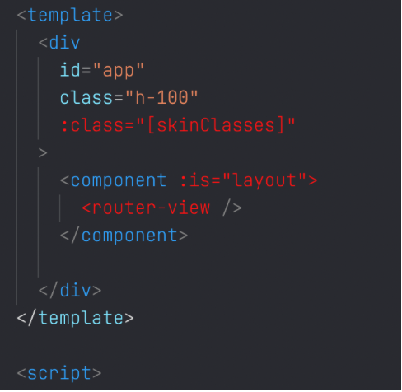
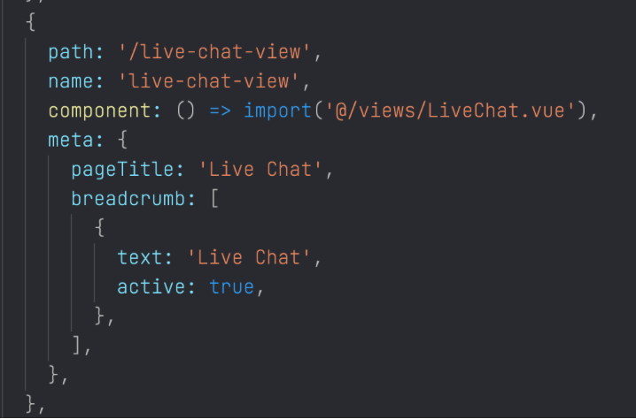
The Builder Pattern

Slide 18
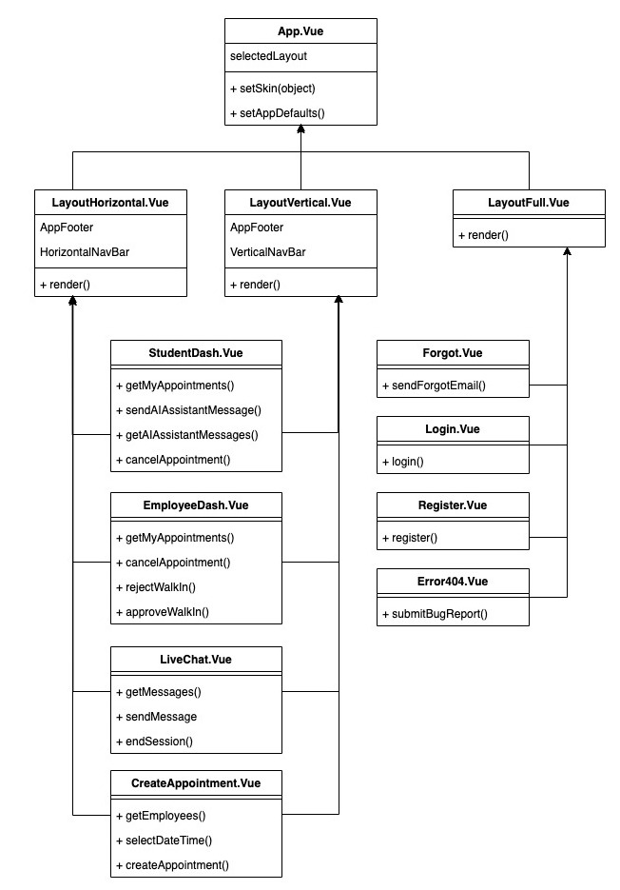
The Builder Pattern

Slide 19

Software Development Tools
Software tools
Our project will be developed using VS Code with Vetur, ESLINT, BABEL, and VS Live Share extensions. The Zhs Unix shell will allow for shell scripting to connect with Firebase CLI.
The Firebase Local Emulator Suite and Firebase CLI will be utilized. Firebase CLI will allow for hosting our project, accessing Firestore and Firebase rules (authentication), and to deploy Firebase Cloud Functions.
Version control will be tracked using GIT and changes will be saved to GitHub.
Jira will be used for issue tracking.
Programming Languages
Our application will also be developed in the HTML/CSS, JavaScript, Node.js and Vue.js environments in combination with PostCSS and Dialogflow to develop our chatbot AI.

Slide 20






Artificial Intelligence
Artificial intelligence has been integrated using the Dialogflow Chatbot.
To allow students to get quick answers, the chatbot has been populated with contents to respond to simple questions and popular FAQs.
If the chatbot is unable to respond to the student’s question, the students would be directed to talk to front desk employee on a one-on-one basis.
The chatbot uses Natural Language Processing to understand what the student is asking using the phrases with which we trained the chatbot.
1. Student Utterance
by asking question
2. Dialog Agent
perform intent matching
Intent 1
Intent 2
Intent 3
Intent 1
Training Phrase
Action & Parameters
Response
3. A response is provided to the student

Slide 21
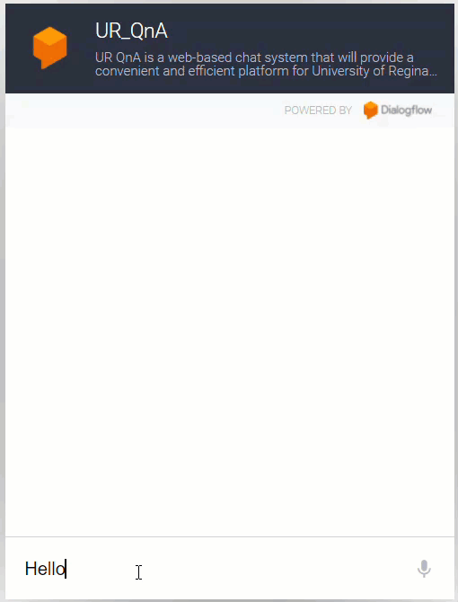
Artificial Intelligence

Slide 22
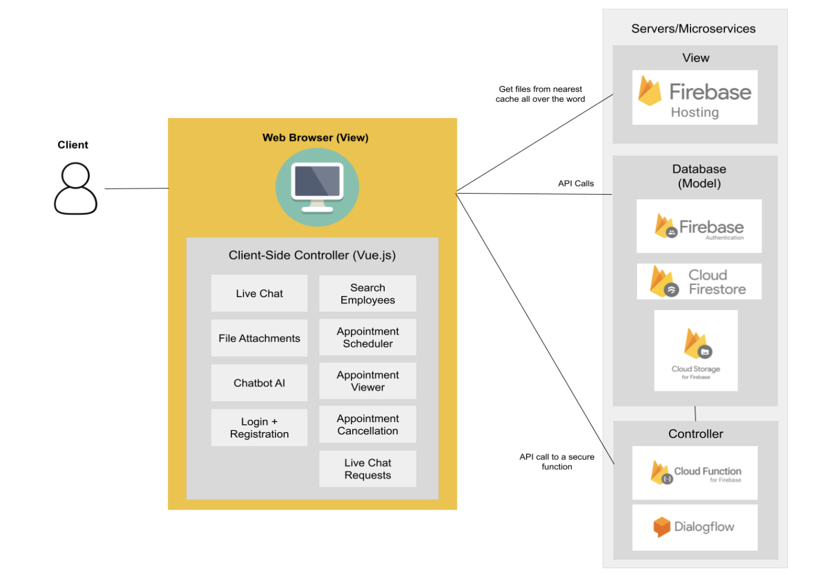
Deployment Diagram

Slide 23
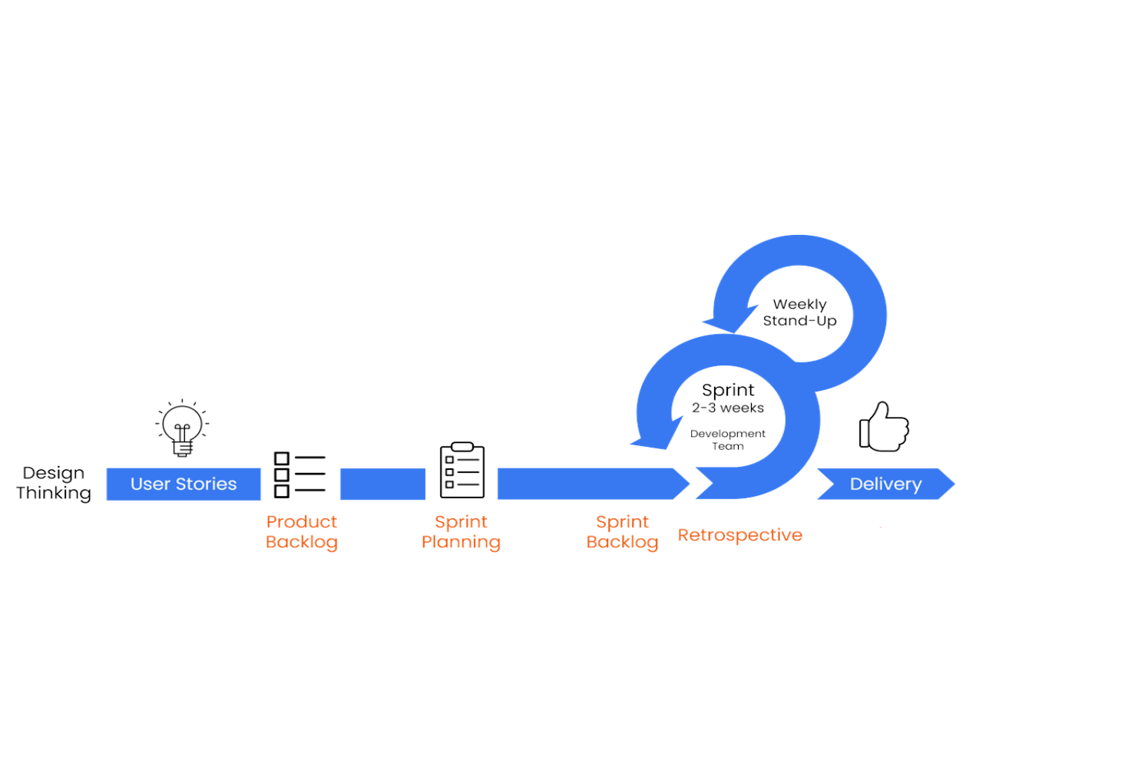
Project Management
We have used the agile development methodology to develop UR QnA.
The development phase was adaptable, allowing the team to adapt to changing functional requirements.
UR QnA was developed incrementally.
Testing was performed after each increment to obtain feedback.
We used the SCRUM Framework for project management purposes.
Functional requirements were incorporated in the Product Backlog as User Stories.
5 Sprints were planned to deliver UR QnA.
A retrospective meeting was conducted at the end of each sprint to plan the next sprint and improve overall procedures.
This Photo by Unknown Author is licensed under CC BY(Modified).

Slide 24

Sprints
Jira was used as the issue tracking software to:
Build the Product Backlog
Perform Sprint Planning
To put deadlines to specific tasks
Assign tasks to team members
As a repository containing shortcuts to diagrams and GitHub.
Add Story Points (defined not only in terms of hours based on the amount of work but also consider the complexity and risks involved) to User Stories.
Sprint Planning
Sprint 1: Sep 19 to Oct 5
Sprint 2: Oct 5 to Oct 26
Sprint 3: Oct 26 to Nov 9
Sprint 4: Nov 9 to Nov 20
Sprint 5: Nov 20 to Nov 29
This Photo by Unknown Author is licensed under CC BY-SA

Slide 25

Sprint Reports
A burndown chart shows the amount of work that has been completed in an epic or sprint.
Link to Jira reports.

Slide 26

Project Demo
https://cs476project.web.app/.
Notes:
Live demo of student and employee side by side.
Live chat.
Chatbot.
Chatbot fallback.

Slide 27
Conclusion and Future Work
UR QnA was a great project to undertake for the Project requirements of the Software Development Course. Team member obtained the opportunity to further broaden their knowledge in the following areas:
Agile methodology and SCRUM framework
Project Management and Jira
Dialogflow chatbot
Live chat systems
Version control
Software architecture, design principles and patterns
Indubitably, due to the time and resources constraints, all functional requirements initially identified were not implemented. There is room for improvement.
The chatbot could be populated with all information about University of Regina.
It may include prediction options.
More functionality could be implemented to improve the communication experience of students and employees.

Slide 28

Thank You Any Questions?

